Slide 1
BETTER DATA FOR BETTER DECISIONS

Slide 2
OVERVIEW
Introduction
Measure What Matters
Defining Data Needs
The National Student Clearinghouse Postsecondary Data Partnership
Regular Conversations About Data – Right People, Right Time, Right Data

Slide 3
OVERVIEW
Introduction
Measure What Matters
Defining Data Needs
The National Student Clearinghouse Postsecondary Data Partnership
Regular Conversations About Data – Right People, Right Time, Right Data

Slide 4
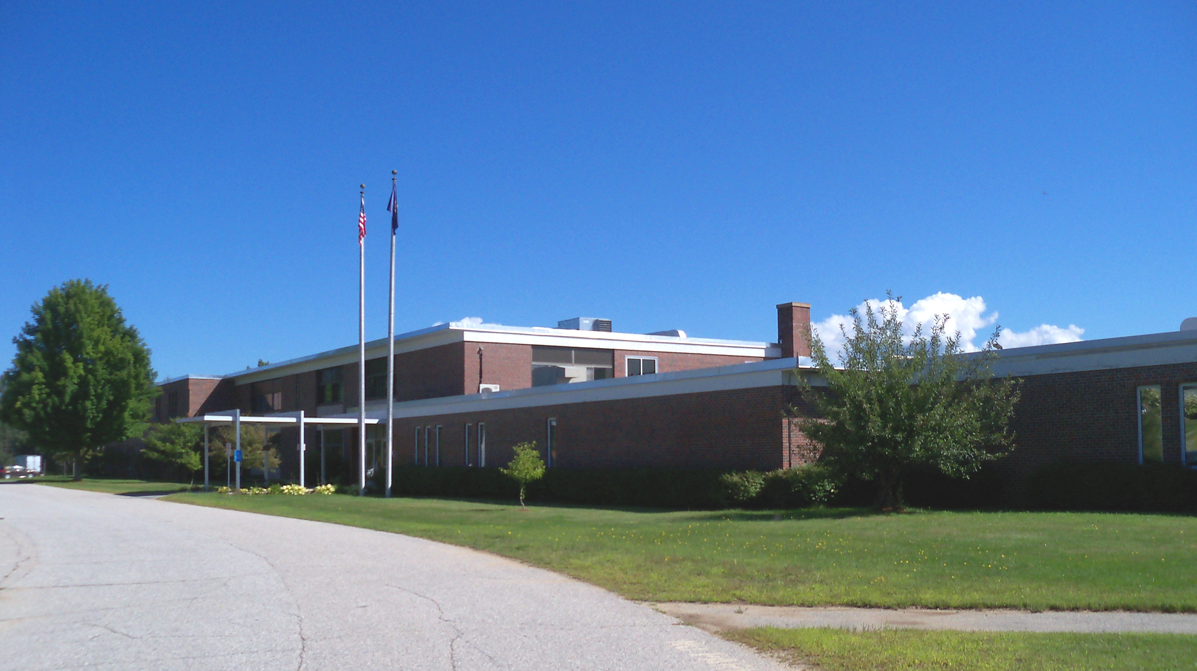
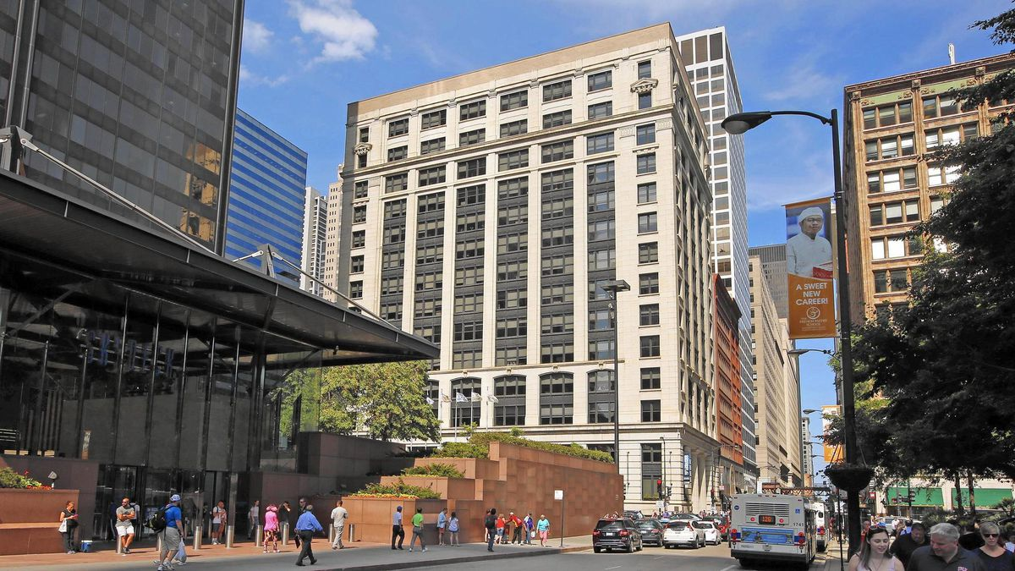
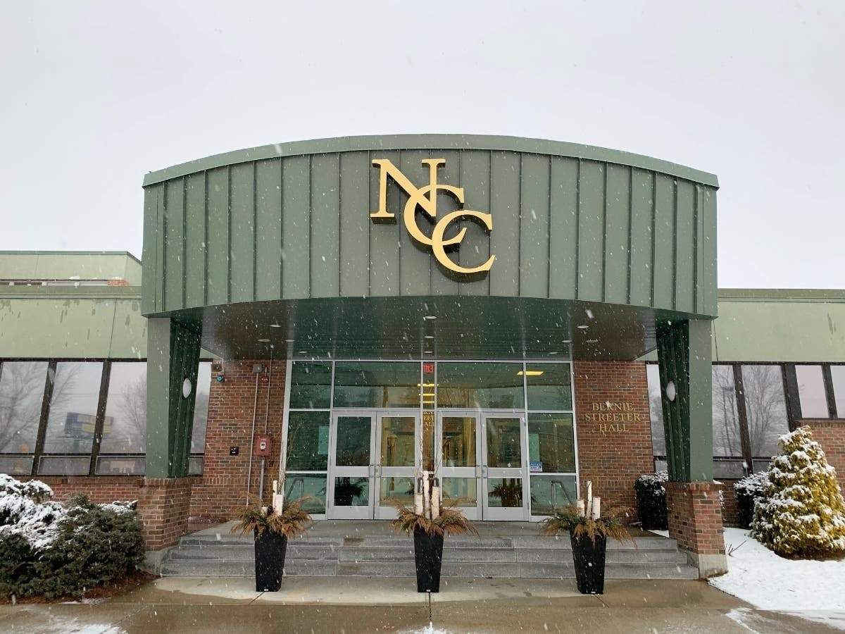

Slide 6
CCA is a bold national advocate for dramatically ​increasing college completion rates and ​closing institutional performance gaps ​by working with states, systems, institutions, and partners to scale highly effective structural reforms and promote policies that improve student success. ​
Mission

Slide 7
48
COMPLETE COLLEGE AMERICA
THE ALLIANCE
CUNY
DC
Complete College Arizona Consortium
Houston
Commonwealth of Northern Mariana Islands
Puerto Rico
Thurgood Marshall College Fund Consortium

Slide 9
VALUES
Student-centered institutions
Equitable structures & outcomes
Data-informed decision making
System-wide collaboration
Implementation at scale

Slide 10
STRATEGIES
Designing the college experience around students
PURPOSE
STRUCTURE
MOMENTUM
SUPPORT
Designing multiple avenues for students to get started, earn credits faster, and stay on track to graduate
Addressing student needs and removing barriers to academic success
Aligning the college experience to each students' goals for the future
Building course road maps that make the path to a degree or valuable workplace credential clear
First-Year Experience
Career Exploration
Academic & Career Alignment
Adult Learner Engagement
Math Pathways
Meta Majors
Academic Maps & Milestones
Smart Schedules
Stackable Certificates & Credentials
Credit for Competency
Multiple Measures
Corequisite Support
Dual Enrollment
15 to Finish/Stay on Track
Active Academic Support
Proactive Advising
360° Coaching
Student Basic Needs Support
CCA Game Changers

Slide 12
TRANSFORMING INSTITUTIONS
We provide a clear framework to guide implementation and bring in content experts from across our network to support the development of detailed action plans.
We support implementation teams to remove obstacles, learn from one another, and garner key wins in service to the project goals.
We provide a clear framework to guide implementation and bring in content experts from across our network to support the development of detailed action plans.

Slide 13
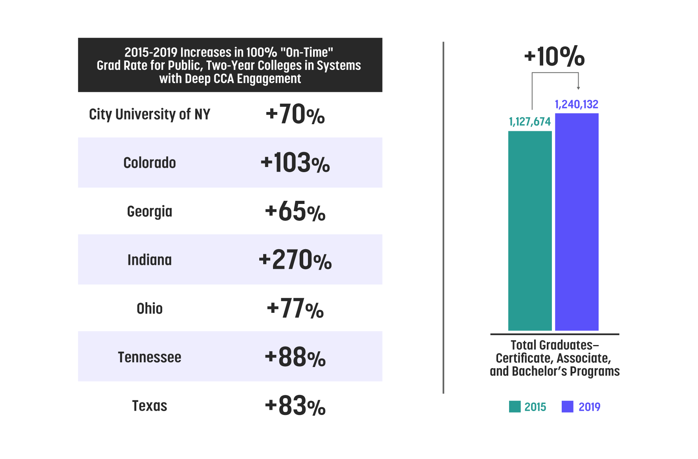
IMPACT
Our Alliance members are getting real results - leading to more degrees and credentials for students across the country.
112,458
Additional graduates
Source: IPEDS per program major graduation rates data

Slide 14
OVERVIEW
Introduction
Measure What Matters
Defining Data Needs
The National Student Clearinghouse Postsecondary Data Partnership
Regular Conversations About Data – Right People, Right Time, Right Data

Slide 15
WHAT PROGRESS LOOKS LIKE
90%
of Alliance members grew on-time graduation rates for community college students
11members
have more than doubled their on-time graduation rates for two-year students
All Alliance members have seen significant increases in the six-year graduation rates at four-year colleges and universities
At both two-years and four-years, most Alliance state and regional colleges and universities have seen growth in graduation rates in all races and ethnicities, especially for students who attend college full-time and students who are 24 years old or younger.

Slide 16
And yet there is still much work to do…
Public four-year college graduation rates, in six years, ages 25 and older
76%
75.4%
Asian
74%
72%
70%
69.1%
46.2%
46%
Total
44%
White
40.8%
44.1%
42%
41.7%
39.9%
40%
Black
38%
36%
35.4%
Latinx
34%
32%
30.8%
10%
30.5%
Source: https://nscresearchcenter.org/completing-college/

Slide 17
And yet there is still much work to do…
Public two-year college graduation rates in six years, all ages
52%
51.2%
Asian
50%
White
48%
46.8%
49.7%
46%
46.7%
44%
43.6%
Total
42%
40.9%
40%
38%
36.8%
35.0%
Latinx
36%
34%
32%
30.1%
30%
Black
28%
26.0%
10%
Source: https://nscresearchcenter.org/completing-college/
*Excludes 2019 data for Asian students due to anomaly

Slide 18
We need better supports for part-time students
Public two-year college graduation rates in six years for exclusively part-time students
White
Asian
Total
14.9%
Latinx
Black
Source: https://nscresearchcenter.org/completing-college/

Slide 19
Hitting an attainment goal is a function of both college-going behavior and college success, and since COVID-19 we are struggling on the former
Undergraduate enrollment, Fall 2019 – Fall 2021
Less Selective Public 4yr
Public 4yr
Public 2yr
Public 4yr
Public 2yr
-2.7%
-12.1%
< 18
18-20
21-24
25-29
> 29
Total
Full-time
Part-time
Source: https://nscresearchcenter.org/stay-informed/

Slide 20
Which type of organization is more likely to be
using data to transform its industry and realize its
mission statement?
Future of workforce, associate, baccalaureate credentials, and of civic engagement
Future of spice and texture in dehydrated foods
20

Slide 21
THE PROBLEM
No one wants to hear, “We’re going to give you data a decade from now.”
//
Gregory DeSantis
Associate Vice President of Student Success and Academic Initiatives
Connecticut State Colleges and Universities

Slide 22
YOU HAVE NO WAY OF KNOWING WHAT’S WORKING – AND WHAT ISN’T
TOO LITTLE, TOO LATE

Slide 23
KEY PERFORMANCE INDICATORS (KPI’s)
The types of measures you care about as a result of mission – postsecondary educational attainment metrics that you can disaggregate by race and household income background -- these are your key performance indicators (KPIs).
LEADING INDICATORS
KPIs should also include measures that can be tracked earlier on and predict college completion are your leading indicators.

Slide 24
KPI’s connected to context and metrics level
Access completion pipeline | Progress Leading indicators of college completion | College completion | Post-completion success
Total enrollment Dual-credit matriculating into college | Fall-to-fall retention English / math pass rates in first year | Graduation rate Total graduates Time-to-degree Credits-to-degree | Median earnings Percent employed in area of education Transfer, post-completion Alumni survey feedback score
Efficiency
Average class size | Cost per enrollment | Cost per graduate | Change in revenue from retention
Promoting college-going behavior is critical, leading to access KPI’s around enrollment.
Since colleges are essentially in the business of creating successful alumni, it is important that your KPI’s include at least one, and maybe two or more, measures in each of these categories

Slide 25
Metrics require specific data elements, and demand to be sliced by various attributes / dimensions

Slide 26
Metrics require specific data elements, and demand to be sliced by various attributes / dimensions
Example of data required to support a specific measure

Slide 27
Translating data to action – at all levels
LOW
 | Common measures |  | Common reporting tools / sources
Post-completion and social mobility | Median wage % employed in area of study Transfer to 4-year | beyond
Graduation – counts and rates | Awards Graduates | % of exp. time Multi-year rate
 | Credits to degree Time to degree
Student success measures that lead to graduation | Enrollment Credit accumulation Gateway course completion | Credit completion ratio Transfer activity Retention
Day-to-day indicators and interventions tracking | Enrollment | Credits activity, by key courses and sections % at-risk - DFW % w/ academic plans Much more |  | SIS | LMS | Advising
FREQUENCY OF CHANGE
HIGH
SLICE ALL THE ABOVE BY DEMOGRAPHIC AND ENROLLMENT

Slide 28
Measuring what matters
List three key performance indicators (KPI’s) in student success for your college. Based on these, indicate three metrics that predict progress on each. Then, list those leading indicators in the table below, alongside associated student success reforms and how those are measured.
EXAMPLE: Graduation rate in 100 percent of expected completion time could be a KPI, with a leading indicator being percent of full-time students who complete thirty credits in their first year. An associated reform is assuring students receive credit for prior learning, with a measure for that being percent of incoming students receiving such credit, tracked weekly.
Student Success Metric | Associated Reform Effort | Reform Metric

Slide 29
Translating data to action – at all levels
LOW
 | Common measures |  | Common reporting tools / sources
Post-completion and social mobility | Median wage % employed in area of study Transfer to 4-year | beyond
Graduation – counts and rates | Awards Graduates | % of exp. time Multi-year rate
 | Credits to degree Time to degree
Student success measures that lead to graduation | Enrollment Credit accumulation Gateway course completion | Credit completion ratio Transfer activity Retention
Day-to-day indicators and interventions tracking | Enrollment | Credits activity, by key courses and sections % at-risk - DFW % w/ academic plans Much more |  | SIS | LMS | Advising
FREQUENCY OF CHANGE
HIGH
SLICE ALL THE ABOVE BY DEMOGRAPHIC AND ENROLLMENT

Slide 30
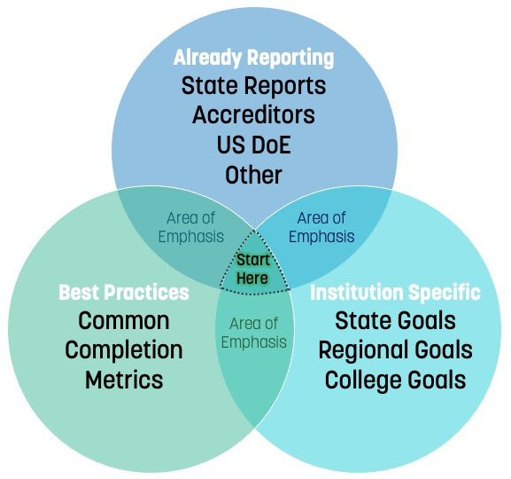
GETTING TO GREAT METRICS
It may be difficult to quantify what you value, and these values are set forth in your college’s mission statement.

Slide 31
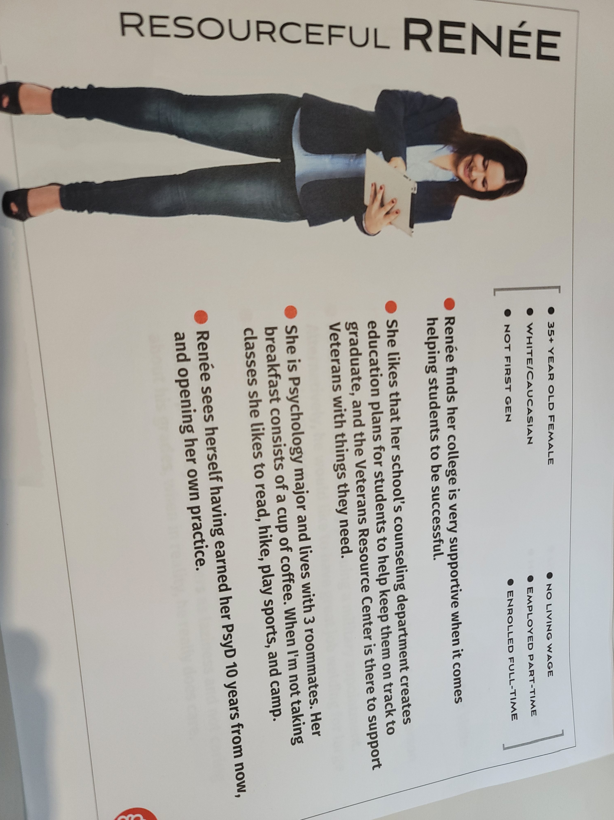
Needing new data points…
How is she supported? How is that support measured?
What does the Veterans Resource Center do?
How many students are on ed plans?
What are the differential success measures for residents versus non?
How will you know whether she opens her own office?

Slide 32
OVERVIEW
Introduction
Measure What Matters
Defining Data Needs
The National Student Clearinghouse Postsecondary Data Partnership
Regular Conversations About Data – Right People, Right Time, Right Data

Slide 33
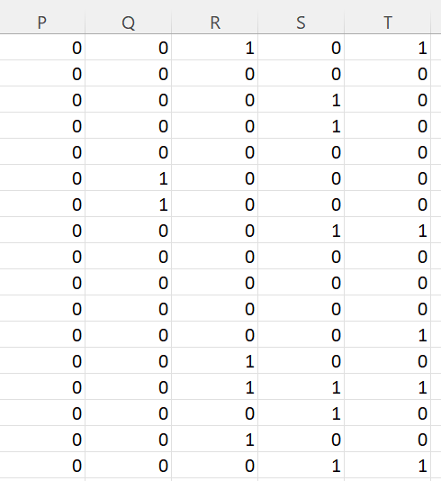
GETTING TO GREAT DATA

Slide 34
Determining data required for entry, and tools in your system
Broad access to reports around metrics derived from KPI’s, as well as the KPI’s themselves, need standard definition.
Some would suggest that this work is a prerequisite to reporting out on the metrics in the first place, but typically surfacing the data is required to elevate discrepancies, and then to iron them out, including through (re)definition.
It is critical to avoid having employees finding their own solutions instead of using agreed upon college or systemwide methods and reports. Avoid contradictory narratives. Conversation and education on newly established, standard definitions behind metrics and reports mitigates not just competing data portrayals, but it moves conversation around data validity to the implications of the data itself.

Slide 35
Based on the table you completed, list these metrics – including the KPI’s. This time, indicate the requirement for the metric (could be multiple), the data source, and whether it is reported in the PDP.
EXAMPLE: Graduation rate in 100 percent of expected completion time could be required for at least three reasons – part of standard reporting to federal government, part of standard reporting to accreditor, and part of standard reporting that drives action internally for your college. The ultimate data source for it is your student information system (SIS), such as Ellucian Banner or Colleague, Oracle PeopleSoft, or Jenzabar. Although not in the PDP, leading indicators of this graduation rate – such as year-to-year retention, provided as another example below - are in the PDP.
 | Requirements | Data Source | In PDP
Y-to-Y retention | IPEDS, WSCUC, Internal | SIS | Yes

Slide 36
OVERVIEW
Introduction
Measure What Matters
Defining Data Needs
The National Student Clearinghouse Postsecondary Data Partnership
Regular Conversations About Data – Right People, Right Time, Right Data

Slide 37
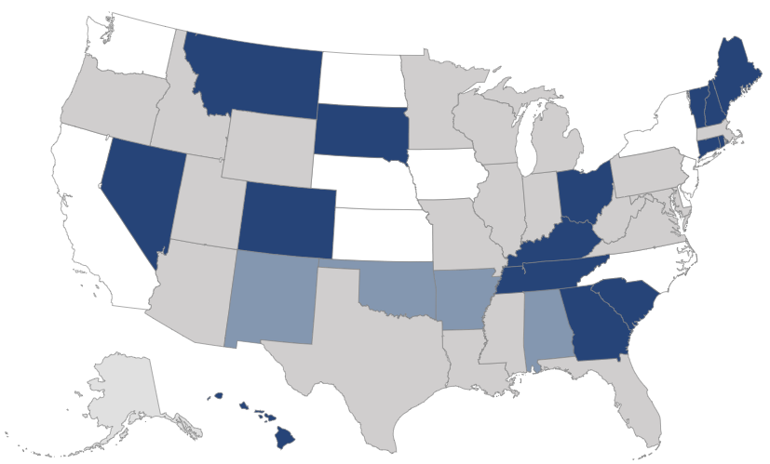
Better Data, Better Decisions: Data on completion surfaced through the Postsecondary Data Partnership (PDP)
Democratizable dashboard reports with all filters for common predictors of college completion
Benchmarking against other colleges in your state
Measurements encompass students who left college / state (e.g., retention in education)
Higher education sector is using this tool for data standardization
 |  | On the PDP
 |  | Lots in state in, or moving to it
 |  | Not on PDP

Slide 38
PDP tracks metrics aligned with CCA strategies
See results on student success reforms across multiple student types
Include transfer activity and subsequent academic performance at other institutions
Access a comprehensive data set to keep up with the pace of your work
Such assistance has never been more critical given that COVID-19 has made the work pace much more frenetic, as it has also made student transfer activity much more prevalent, and budgets unbearably tight.

Slide 39
PDP addresses data access challenges on at least five major fronts
Data Access Challenges Today |  | PDP-based data collection for CCA partners
Lack of consistency in third-party data submission templates |  | Single point of submission to NSC for CCA & other orgs participating with the PDP
Existing benchmarks in IPEDS use lagging indicators |  | Metrics line up with student success reforms (completion ratio, credit accumulation, gateway course completion, & retention)
Difficulty in reporting and visualizing leading indicators of student completion |  | Analysis is paired with filterable visual dashboard for executive-level decision-making
National metrics exclude many students |  | Inclusion of all students and transfer activity, not just first-time or just full-time starters
Current economic crises are posing threats to student success |  | Better data means better decisions, and responsive partnership in product development

Slide 40
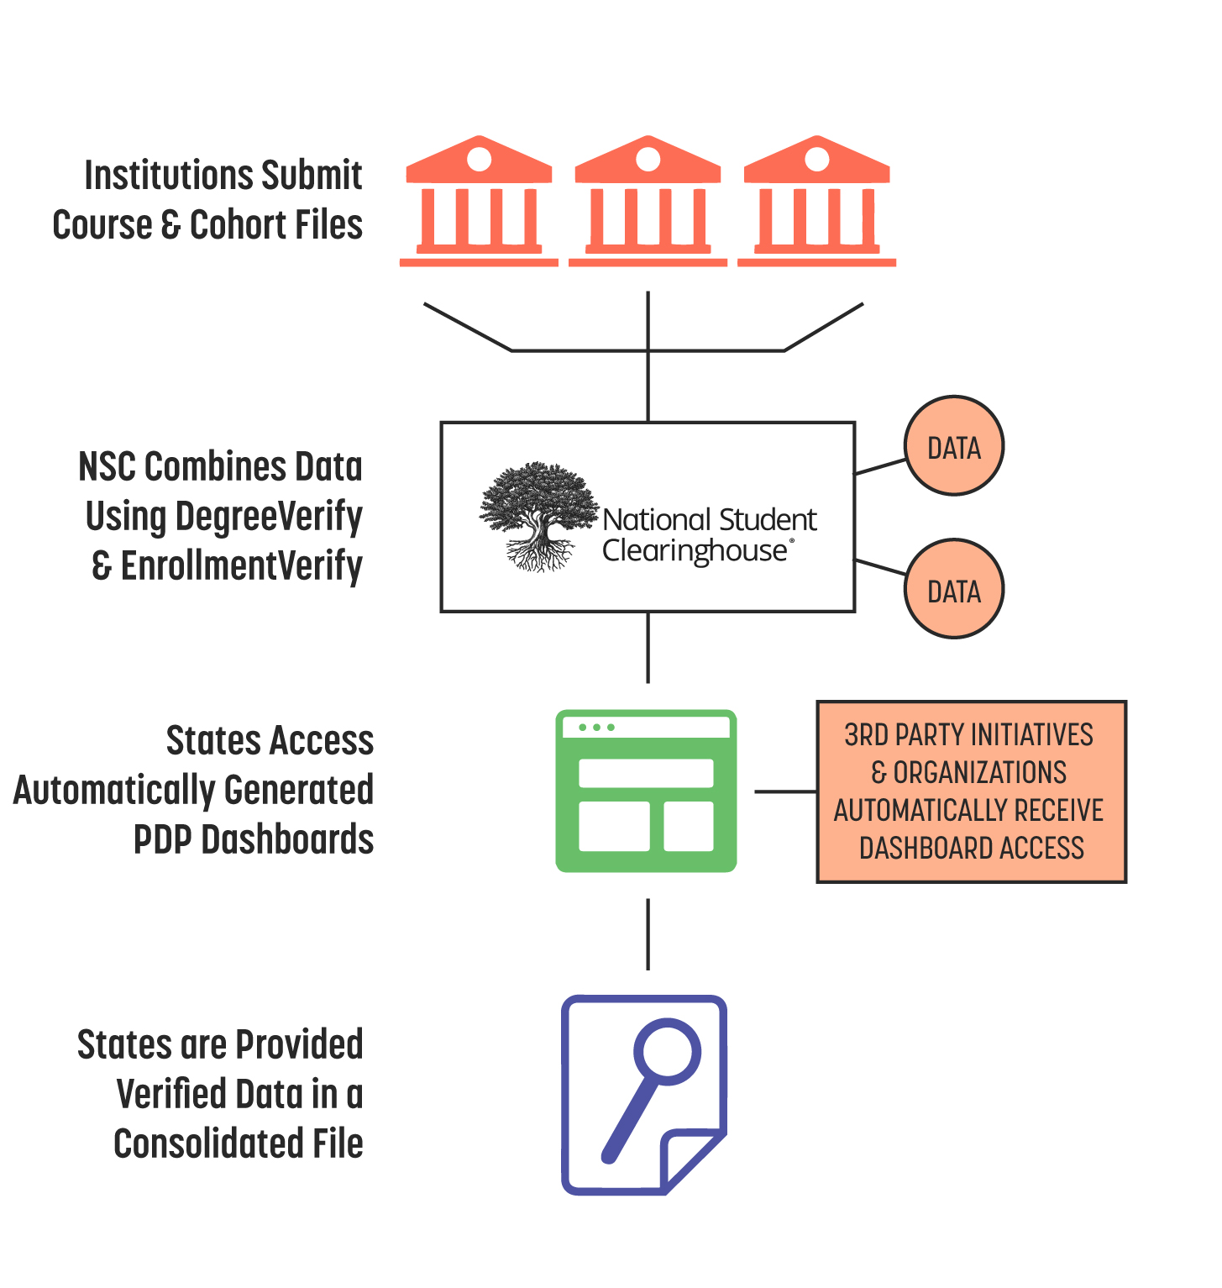
A New Approach to support fast change, for equity and justice
A NEW APPROACH
How the Postsecondary Data Partnership disseminates information, streamlining reporting, standardizing data and making insights more accessible.
National Student Clearinghouse’s Postsecondary Data Partnership helps you...
Spend fewer resources on data reporting and more time making informed decisions.
Quickly assess and analyze current policies and priorities.
Promote collaboration and learning with consistent metrics and standardized reporting.
Easily spot and analyze equity gaps.
Gain a more accurate and inclusive picture of the students you serve.
Benefit from ongoing investment and improvements.
Notes:
Key points for state and system leaders

Slide 41
Translating data to action – at all levels
LOW
 | Common measures |  | Common reporting tools / sources
Post-completion and social mobility | Median wage % employed in area of study Transfer to 4-year | beyond
Graduation – counts and rates | Awards Graduates | % of exp. time Multi-year rate
 | Credits to degree Time to degree
Student success measures that lead to graduation | Enrollment Credit accumulation Gateway course completion | Credit completion ratio Transfer activity Retention
Day-to-day indicators and interventions tracking | Enrollment | Credits activity, by key courses and sections % at-risk - DFW % w/ academic plans Much more |  | SIS | LMS | Advising
FREQUENCY OF CHANGE
HIGH
SLICE ALL THE ABOVE BY DEMOGRAPHIC AND ENROLLMENT

Slide 42
PDP Dashboard Metrics – Which do you presently track and which would you like to benchmark?
Gateway-Course Completion. Identify early whether your students are on track by using the PDP to measure math and English gateway-course completion rates.
Credit Accumulation Rate. Determine what proportion of your students are progressing toward credential completion. See which students are earning sufficient credits in their first year and which need more support.
Credit Completion Ratio. Find out how successful students have been at completing the credits they attempted in their first academic year. This is a leading indicator of a student’s progress toward completion of a credential.
Retention and Persistence. Get a fuller picture of your students’ achievements. Success is measured not only by the number of students who complete their studies on your campus (retention) but also by the number who continue their education elsewhere (persistence). The PDP applies comprehensive enrollment and degree data from the National Student Clearinghouse to tell you about student outcomes on your campus and beyond.
Transfers. See a snapshot view of your institution’s transfer rate, as well as more detailed information about students’ outcomes after they transfer.
Outcome Measures. Review your students’ completion rates and earned credentials throughout their education journey. The PDP enables you to review outcomes at two-, four-, six-, or eight-year intervals for enrolled students and students who are no longer enrolled. It also enables you to review the credentials the students earned and whether the students are still enrolled at your institution or another.
Credentials Conferred and Time to Credential. Measure how many credentials students obtained in a given year, how long it took students to obtain their credentials, and which groups of students take longer to attain those credentials.

Slide 43
Data and Reporting Tools
Common Data Technology Tools at Your College
Relationships Required Between Tools Listed Above
Tools / Systems / Mechanisms you Need to Have
Stakeholder Group | System Need

Slide 44
OVERVIEW
Introduction
Measure What Matters
Defining Data Needs
The National Student Clearinghouse Postsecondary Data Partnership
Regular Conversations About Data – Right People, Right Time, Right Data

Slide 45
Principles for strong performance dialogs
Having regular conversations about data is nothing less than using all the measures you deemed important, in alignment with your mission, and all the levels and sources and tools required to make it real and turning it into a management engine.
It means ensuring that the right people are having the right data conversations at the right times to make performance management the bedrock of implementing student success reforms and closing equity gaps.
Regular conversations about metrics in this way, geared towards the KPI’s and leading indicators as associated to the student success reforms you defined earlier in this session, is nothing less than relentless attention to student success itself.
In this way, the success reforms do not just produce the data, but the data itself cyclically refines the reforms under implementation in a way that makes sense for your college, and in a way that empowers every employee, especially advising and the professoriate, as well as students and the public. Facilitation is never more important for such a process.

Slide 46
Principles for strong performance dialogs
Metrics
Dialogs
Description
Description
Long-term outcomes
Overview of outcomes / KPIs with less frequency
E.g., 65 by 25 metrics
Dialogs
Frequency depends on organizational level
E.g., Monthly CFO meeting. Board?
Leading indicators
Overview of effectiveness and efficiency factors that influence outcomes
Operations
Identify actions to improve outcomes
E.g., Action Items
46

Slide 47
System-wide
ownership for our goals
Leadership and
management capacity
The purpose of Performance Dialogs is to provide a process to continually review and refine organizational practices using a data-driven, evidence-based lens
Every individual in the organization has ownership and responsibility in realizing goals
Our system must have leaders at all levels model change management mindsets and behaviors
Train, develop, and coach individuals to identify problems through data and work with their teams to address the problems proactively and effectively
Culture of
data inquiry
Culture of
action and accountability
Train and develop individuals to quickly analyze data to solve organizational problems
Encourage individuals to creatively and persistently inquire using data to understand complex problems
Develop agility to address problems and follow-through
Accountability system needs to be simple, transparent

Slide 48
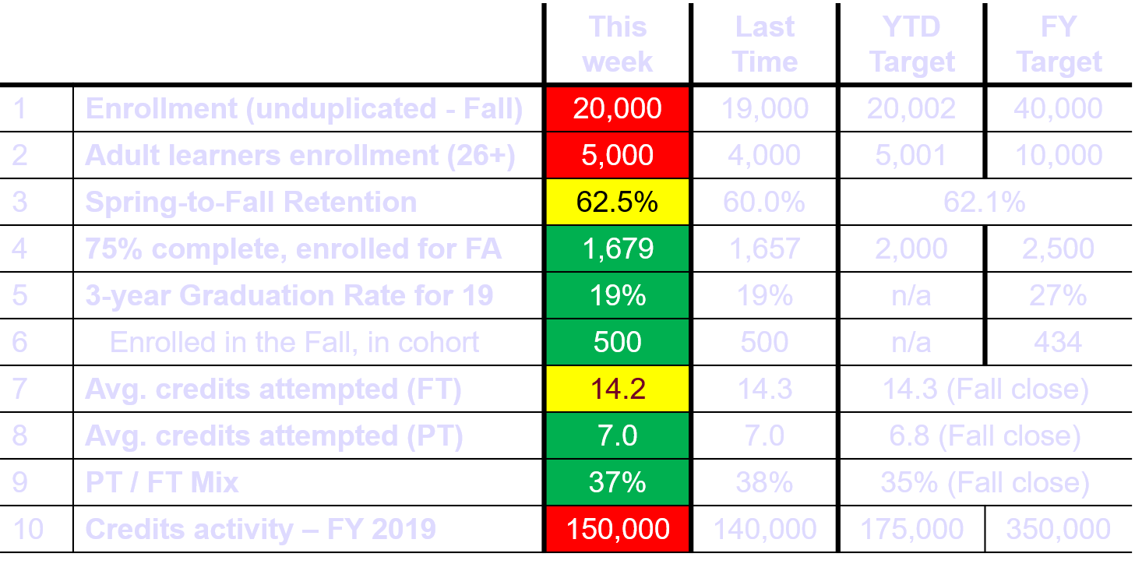
Student Success Dashboard – As of 7/18/2022
Dummy data supplied
48

Slide 49
Education Planning – Fall 2022 Registered Students
Most Planner Activity is at College Three (C3)
Planner activity across the Colleges
4,000
2,000
1,000
1,000
1,000
2,000
1,200
400
600
1,000
500
No plan activity
50.0%
50.0%
50.0%
50.0%
50.0%
70.0%
75.0%
66.7%
70.0%
80.0%
91.7%
Plan Activity
50.0%
50.0%
50.0%
50.0%
50.0%
College
Three
New students
FT FT
30.0%
25.0%
33.3%
30.0%
20.0%
8.3%
C1
C2
C3
C4
C1
C2
C3
C4
Dummy data supplied
All students
First-time to College

Slide 50
Performance dialogs
Performance dialog item |  |  |  | Setup the dialog
Metric | What it leads to | Reforms | Frequency of change | Conversation leader | Tech and length | Kick off

Slide 51
Performance dialog discussion points
All operational leads – from student service, to finance, to tutoring and admissions – are empowered to know precisely which measures they are accountable for and can access them on-demand.
Peer accountabilities can review each other’s data. For example, on any given day, one advisor can see their caseload’s retention rate vis a vis an anonymized benchmark of the entire advising department.
Results are discussed frequently. For example, the English department meets bi-weekly to discuss homework assignment turn-in rates, attrition rates, and other immediate indicators of student success.
Variation points to areas that require action. to change, areas to act. Variation is central to management. For example, if disaggregated data shows different outcomes for students of different races/ethnicity has different outcomes on a critical measure, such as a graduation or retention rate for a given cohort, then your college has an institutional performance gap to bridge through the right reform efforts. If one advisor’s caseload is significantly underperforming compared to their peers, there may be an opportunity for professional development, the need to re-examine advising assignments, or both.

Slide 52
QUESTIONS

